Slide 1
How to Read a Realistic Rendering Paper
Morgan McGuire
CS 888 Fall’19
University of Waterloo
Notes:
[These are lecture notes from a graduate course, which were prepared with feedback from co-teachers Stephen Mann and Craig Kaplan and colleagues Peter Shirley and Ward Lopes]

Slide 2

Overview
Křivánek et al., Unifying points, beams, and paths in volumetric light transport simulation, ACM ToG/SIGGRAPH 2014

Slide 3
Motivation (for Reading Research Papers in this Course)
Learn more efficiently and from primary sources
Access research not available in textbooks
Training for your own research
Notes:
A major part of this course is teaching you how to learn from research papers and evaluate them critically.
There are several reasons:
Learn more efficiently and from primary sources, without the reinterpretation and shifted emphasis of textbooks.
This will give you access to work that is cutting edge, good ideas lost from the main stream, and in other fields. None of those are well-represented in textbooks. (For better and for worse: it is a service that textbooks remove outdated ideas and disproven results; but if you want to master an area, you may need to know that history and be able to perform pruning for yourself on newer work)
It will also train you to perform research, write that work up for publication, and referee and edit the work of others.
With regards to performing research, the “story” told in a paper of the authors’ motivation, path to discovering a solution, and conclusions is often not how it really happened…but is often how it should have happened in an ideal world and a good model to aspire to.

Slide 4
Summary
Read in multiple passes
Skip around (in a specific way) to decode the paper
Detect reasons to stop reading early
Evaluate critically as an active reader
Rederive key equations/code
Follow forward and backward references
Notes:
Most of today’s presentation is context for understanding research papers. I’ll address the topic of how to read them relatively quickly at the end once you’re familiar with the parts of papers. Here’s the punchline for that part.
The goal of a textbook is to help you learn something deeply and with context.
Papers are not textbooks. They are highly constrained and thus rely on significant reader knowledge to interpret.
They also serve more audiences than yourself. In fact, teaching you is typically not their among the main goals of the paper.
So, you have to work much harder to learn a topic from a paper than a textbook, and need specific skills. Those skills will make you an active reader, and a bit of a research paper archeologist, following this process:
…
Note that one reason you don’t read research papers straight through from start to finish is that you’re usually trying to figure out if this is the right paper to read. It takes a long time to unpack a paper and fully understand it. If what you’re looking for isn’t there, you’d like to know that as soon as possible so that you can invest that time reading a different paper. So, we read in multiple passes, looking for specific kinds of information, and continuously evaluate if we have extracted enough information from the work.

Slide 5
Recommended Reading
S. Keshav, How to read a paper, SIGCOMM Review 2007 (2016 version) https://blizzard.cs.uwaterloo.ca/keshav/home/Papers/data/07/paper-reading.pdf
A. J. Smith, The Task of the Referee, Computer 1990 https://www.cs.utexas.edu/users/mckinley/notes/reviewing-smith.pdf
K. Fatahalian, What makes a (graphics) systems paper beautiful, web page, 2019 http://graphics.stanford.edu/~kayvonf/notes/systemspaper/
D. Salesin, How to write a SIGGRAPH paper, SIGGRAPH ASIA 2016 Courses https://dl.acm.org/citation.cfm?id=2988471
J. Kajiya, How to get your SIGGRAPH paper rejected, technical report 1993 https://www.siggraph.org/sites/default/files/kajiya.pdf
Notes:
There are many good articles, primarily by other faculty and written for courses such as this, available on the web discussing how to read research papers.
I recommend also reading articles about how to write and review a research paper, which will give insight into the structure and motivation for sections of a paper, as well as train you for participating in the peer review process.

Slide 6
Context
Literature
Scientific literature
Computer science
Computer graphics
Rendering
Physically-based rendering
Notes:
The advice I’m presenting is tailored for the material that you’ll be reading in this course on physically-based rendering via advanced ray tracing techniques.
A lot of what we’ll discuss today generalizes, and I’ll try to specifically note cases that don’t generalize
But you should be aware that we’re down here in a specific point of a vast hierarchy of written material.
You should also be aware that a ”modern” graphics paper written after the mid 1990s is a little different than a “classic” paper written in the 70s or 80s because the field and formats have matured. I’m going to focus today on modern papers even though we will also read some classic papers in this course.

Slide 7
Potential Author Goals
Describe a new problem
Describe a new solution
Advance understanding of an existing problem or solution
Advocate for a specific approach to a problem
Expose a flaw in a previous solution
Aid in implementation of a solution
Demonstrate correctness/quality/performance of a solution
Describe a failed approach (negative result)
Notes:
There are many reasons

Slide 8
Potential Author Constraints (Pragmatic Goals)
Satisfy page count limitation
Persuade the reviewers/editor that the paper is acceptable [novel, correct, significant, clever, clear, …PC]
Convince a promotion/thesis/funding/hiring committee that the authors perform important research
Impress the authors’ peers or make the authors feel valued
Prevent others from patenting a technique
Support the authors’ patent of a technique

Slide 9
Potential Reader Goals (1/2)
Learn about a problem or field new to the reader
Learn an incremental advance as an experienced reader
Learn a new way of thinking about the problem
Implement a solution
Notes:
There are a lot of reasons someone might read a research paper.
Your goal in this course will primarily be the first one on this slide, although all of the ones on this slide will all matter at various points.

Slide 10
Potential Reader Goals (2/2)
Study a role model for how to write a similar paper
Distinguish the reader’s own work from the authors’
Evaluate the paper for peer review
Decide if the paper should be accepted
Evaluate the authors’ abilities
Write a survey of related work
Satisfy course requirement
Notes:
There are other reasons that people read papers.
I hope you never read anything solely because I assigned it, without the intention of actually learning from the work.
But I do expect that you’ll read many papers for reasons beyond learning about the topics, because you should. As you reach senior years as a graduate student, or if you continue in the field, you will be asked to review and edit papers.
When writing a paper, I often look to my favorite papers in computer science as role models for a good tone and structure.

Slide 11
Publication Forms
Journal paper
Conference paper
Conference short paper
Poster
Invited paper
Presentation without paper
Chapter in an edited collection
Chapter in an author’s own book
Technical report/white paper
Patent
Blog/web page
Peer reviewed
Curated
Self-published
Notes:
Three major categories, based on peer review.
Fully peer reviewed work has been scrutinized by typically 3-5 experts in the area. They’ve checked it for correctness, writing quality, and reproducibility. The quality of this checking varies depending on the standards and process of the venue and the peers—they could be 20 year veterans, students reviewing their first paper, someone going line by line through one paper, or someone with 30 other papers to review that week.
Peer review isn’t an assurance of quality, but it indicates that the scientific community accepts this work as worth reading and adhering to current standards. This tends to force work a bit towards the mean—the very best work can be blunted by this process, as well as less-useful texts being improved or outright excluded by it.
“Curated” work is ”Lightly reviewed”. The subject matter, author, and outline of the material have been approved by peers (maybe a single editor or chairperson), but the actual content has not been verified in most cases. Frequently, only a proposal was seen by the reviewer and not the final version. The largest quality signal here is the reputations of the venue and the authors. Expect higher variation in correctness and writing standard than peer review…
In rendering, game developers and some offline rendering experts working in the industry prefer publishing in these forms because it is more efficient from the authors’ perspective. Many influential works appeared as book chapters and Game Developers Conference talks instead of peer reviewed papers.
Self-published work is unreviewed. It has the highest variance. This is a very good way for authors to present new results and readers to stay on top of a fast-moving field, where best practices can change every few months. It is also important for a field driven by applied and industry research, where authors/inventors may not have institutional support for participating in the peer-review process. When One is fully dependent on the authors’ reputation. Again, some very influential rendering work has appeared in these forms, such as the PBRT book and Stephen Hill’s blog, which won Academy and SIGGRAPH awards.

Slide 12
Some Realistic Rendering Venues
ACM ToG / SIGGRAPH / SIGGRAPH Asia
IEEE TVCG
Eurographics
EGSR
HPG, I3D, JCGT, PACM
CG&A
GPU Pro, ShaderX, GPU Gems, Ray Tracing Gems
Notes:
You can tell a lot about a paper and whether it will have what you’re looking for just by where it was published.
The big venues tend to favor academic research; they are always impressive and good science but have varying levels of short-term applicability and tend a little conservative.
ACM Transactions on Graphics, “ToG”, is a journal that has become essentially the same as the SIGGRAPH annual conference and its newer SIGGRAPH Asia counterpart. These all feature big results, usually with polished exposition and figures and many motivating examples.
Transactions on Visualization and Computer Graphics is essentially IEEE’s version of ToG.
The Eurographics annual conference is another big venue.
Smaller conferences tend towards more risky and aggressive ideas, as well as ones closer to industry practice. These are often good papers to reproduce as student projects.
The Eurographics Symposium on Rendering (EGSR) favors more theoretical work in rendering. EGSR papers tend more towards offline rendering.
High Performance Graphics (HPG) and Interactive 3D Graphics and Games (I3D) are conferences that tend to favor real-time rendering and practical, industry-facing solutions. They are closely related to the Journal of Computer Graphics Techniques and Proceedings of the ACM journals.
IEEE Computer Graphics & Applications is an outlier as a a more informal journal tied to practice and implications.
The books on the last line are examples of journal-like edited collections favored by game developers. They aren’t peer-reviewed in the traditional sense and tend to be less academic, but are in many ways similar to JCGT as extremely practical advice on specific problems. These tend to have drop-in solutions for state-of-the-art renderers, especially real-time ones.

Slide 13
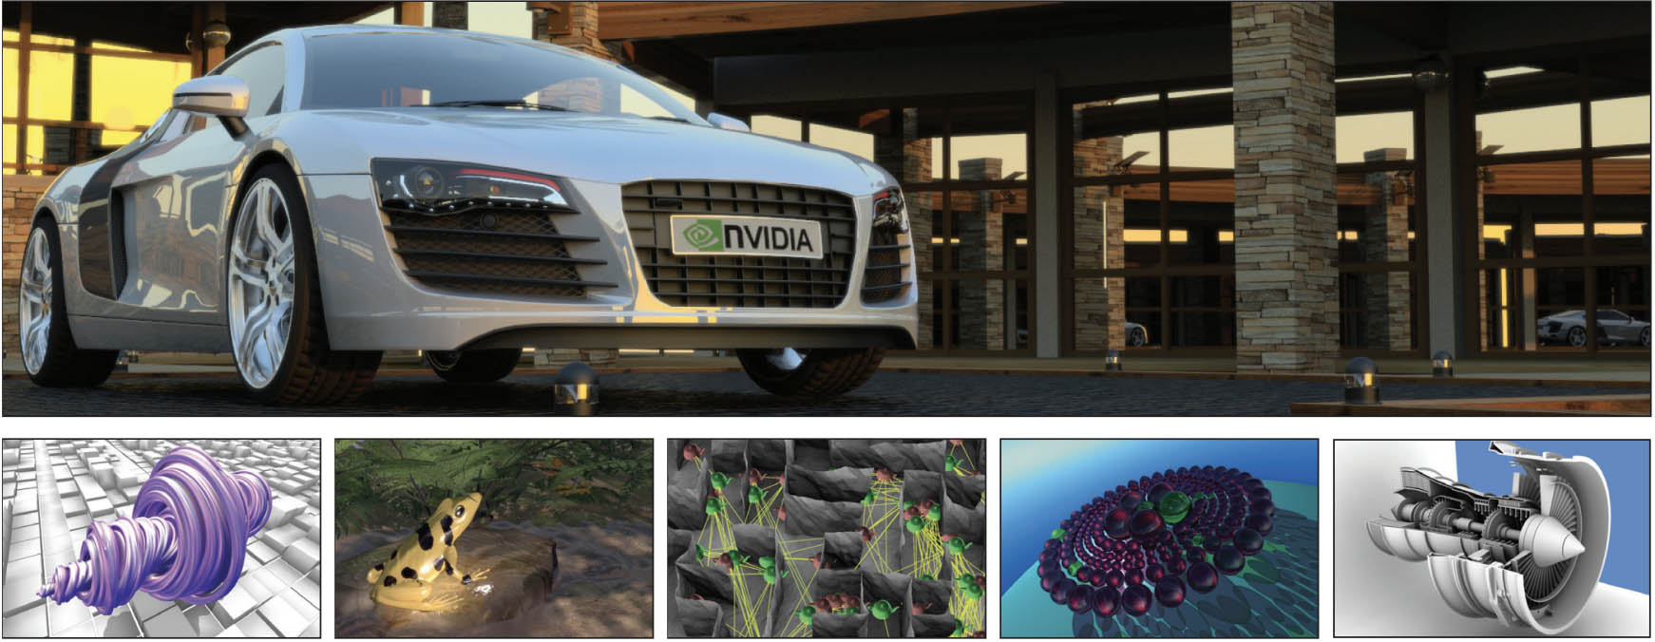
Structure of a Paper
Parker et al., GPU Ray Tracing, Comm ACM 2013

Slide 14
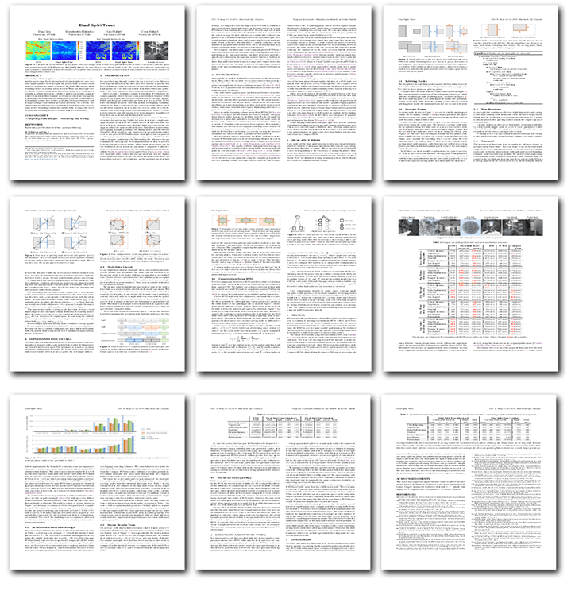
Rendering Research Paper Structure
Teaser Result
Abstract
Introduction
Related work
Algorithm or System
Evaluation
Conclusions & Discussion
Bibliography
Appendices & Supplement
Dual split trees, Lin et al., I3D'19
Notes:
Rendering papers tend to follow this main structure.
Most scientific writing is similar, although the emphasis shifts by field. For example, “related work” is usually a full-page survey in rendering but in psychology or economics is often a handful of citations in passing. In lab sciences, there is often a significant methodology section, and in mathematics there is rarely an experimental evaluation section.

Slide 15
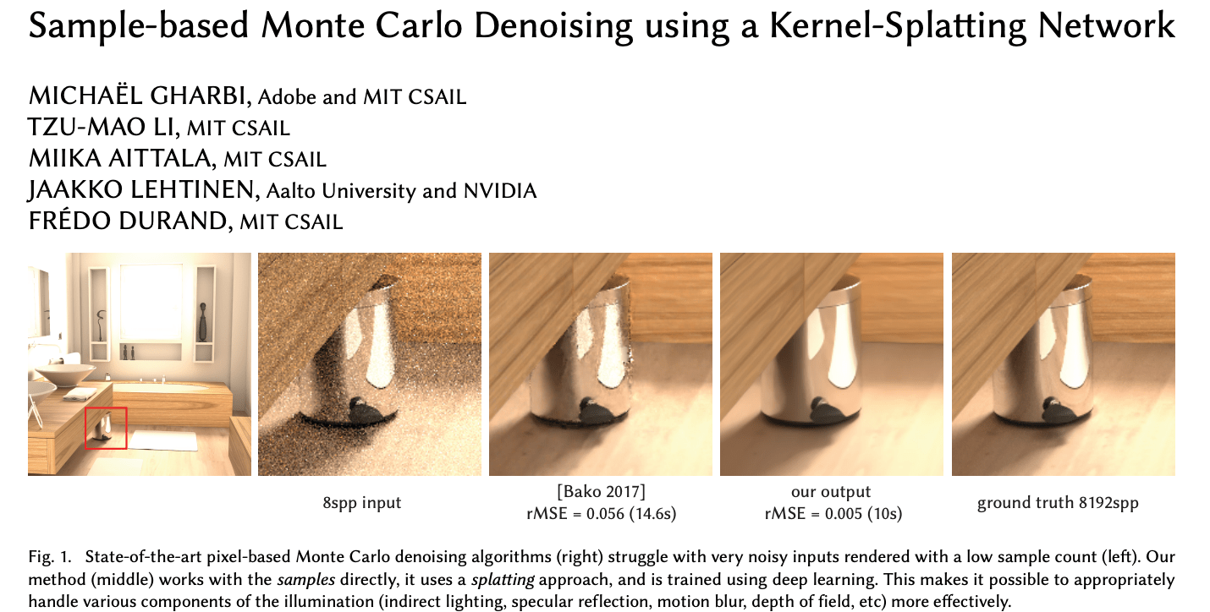
Teaser Result
Notes:
Modern computer graphics papers almost always begin with a “teaser” image that shows the main result of the work and compares it to alternative methods.
This is a terrific practice which allows you to immediately understand what problem the paper is solving and how well its solution work in the best case.
It also provides a nice visual reference—there are many papers that I remember, e.g., as “the one with the egg pictures” or “the ring caustic in grass”, because of some iconic image from the paper.

Slide 16
Title & Abstract
Wide BVH Traversal with a Short Stack
K. Vaidyanathan S. Woop C. Benthin
Intel Corporation
Abstract
Compressed wide bounding volume hierarchies can significantly improve the performance of incoherent ray traversal, through a smaller working set of inner nodes and therefore a higher cache hit rate. While inner nodes in the hierarchy can be compressed, the size of the working set for a full traversal stack remains a significant overhead. In this paper we introduce an algorithm for wide bounding volume hierarchy (BVH) traversal that uses a short stack of just a few entries. This stack can be fully stored in scarce on-chip memory, which is especially important for GPUs and dedicated ray tracing hardware implementations. Our approach in particular generalizes the restart trail algorithm for binary BVHs to BVHs of arbitrary widths. Applying our algorithm to wide BVHs, we demonstrate that the number of traversal steps with just five stack entries is close to that of a full traversal stack. We also propose an extension to efficiently cull leaf nodes when a closer intersection has been found, which reduces ray primitive intersections by up to 14%.
Notes:
An abstract tells you:
The problem that the paper is solving
Why previous solutions are imperfect
The key idea for the new solution or insight into how to look at the problem
How well the new solution works
For a really good scientific paper, the title is an abstract of the abstract, giving you the most important information right away.

Slide 17
Title & Abstract
Wide BVH Traversal with a Short Stack
K. Vaidyanathan S. Woop C. Benthin
Intel Corporation
The problem/challenge/goal
Prior limitation
Key idea
Abstract
Compressed wide bounding volume hierarchies can significantly improve the performance of incoherent ray traversal, through a smaller working set of inner nodes and therefore a higher cache hit rate. While inner nodes in the hierarchy can be compressed, the size of the working set for a full traversal stack remains a significant overhead. In this paper we introduce an algorithm for wide bounding volume hierarchy (BVH) traversal that uses a short stack of just a few entries. This stack can be fully stored in scarce on-chip memory, which is especially important for GPUs and dedicated ray tracing hardware implementations. Our approach in particular generalizes the restart trail algorithm for binary BVHs to BVHs of arbitrary widths. Applying our algorithm to wide BVHs, we demonstrate that the number of traversal steps with just five stack entries is close to that of a full traversal stack. We also propose an extension to efficiently cull leaf nodes when a closer intersection has been found, which reduces ray primitive intersections by up to 14%.
Deliverable
How well it works
Notes:
In this particular example, I like that:
The abstract gives quantitative results
The title makes the problem (wide BVH traversal) and solution (short stack) clear
The abstract covers all of the areas that it should
The abstract is short!
For what it’s worth, this could be improved by:
Quantifying the speedup for GPU BVH traversal using this stack, which is the real payoff
Moving the “In this paper…” sentence to the front, so that I immediately know what it is delivering: an algorithm
Explaining why keeping the stack in registers (not just “on chip”) gives such a huge speedup for GPUs
Removing some of the repetition, “short stack…just a few entries”, “just five stack entries” to make room for the above
…but writing a paper isn’t our goal today, and I want to leave you with the high-order impression that this is a good abstract and that the highlighted words are what you’re trying to get from it as a reader.

Slide 18
Introduction
1 INTRODUCTION
Monte Carlo (MC) integration is an essential tool in light transport simulation [Pharr et al. 2016; Veach 1997] and other fields of science and engineering [Kalos and Whitlock 2008]. An inherent problem of MC integration is its slow convergence, which is why numerous variance reduction schemes have been proposed, notably importance sampling. Its extension, known as multiple importance sampling (MIS) [Veach and Guibas 1995], is particularly versatile as it enables combining different sampling techniques in a robust way to form better MC estimates…
Our work focuses on weighting functions for MIS. We derive...
We provide further theoretical insights into...
Our practical contribution consists in proof-of-concept applications of the optimal weighting scheme in light transport...
Very readable, high-level
Background on the problem
Seminal related work citations
Description of constraints
Philosophy of this paper’s approach
Contributions of this paper
This is what you need for your 1st read
Optimal multiple importance sampling, Kondapaneni et al., SIGGRAPH'19

Slide 19
Related Work
2 RELATED WORK
Monte Carlo Methods. Kajiya and Von Herzen [1984] were the first to use path tracing for numerically estimating radiative transfer in volumes [Chandrasekhar 1960]..., these methods are far from reaching interactive frame rates when used on the highly scattering materials that we target…
We explore a new approach based on approximating the cloud geometry by a hierarchical descriptor and predict local illumination using a deep neural network….
…All these methods are either interactive, or produce high-fidelity images, but none of them achieve both concurrently…
Neural Networks. Deep neural networks (see Bengio et al. [2013]; LeCun et al.[2015] for a comprehensive review) are able to efficiently model complex relationships between input and output variables in a highly non-linear manner… We use a hierarchical feature and feed its levels into the network progressively..
Mini survey paper
Categorize the previous work and position this paper
Explain differences between this and previous papers
More detail on what is completely new
Deep scattering: rendering atmospheric clouds with radiance-predicting neural networks, Kallweit et al., SIGGRAPH'17
Notes:
What you’re trying to get on your first pass through the paper is an understanding of “how is this different from other approaches”, which is what I’m highlighting in pink.
If you don’t know much about this paper’s particular area, then the blue categorization will give you some context, however you should just read the subsection/paragraph titles at first and skip most of the text.

Slide 20
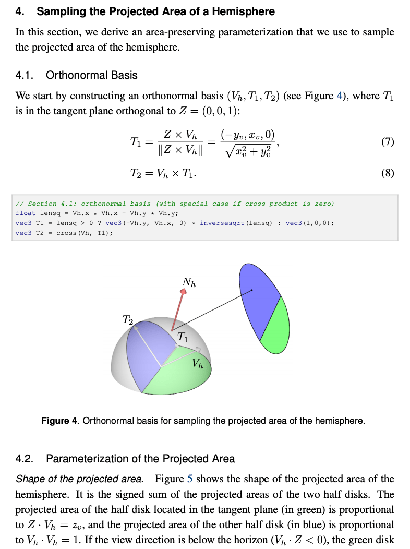
Algorithm or System
Main body of the new technique
Includes both derivation and solution
May span multiple sections
Only a small part of this is the new contribution you’re looking for!
…and it may depend on pieces that only appear in other work, not here
Sampling the GGX distribution of visible normals, Heitz, JCGT'18

Slide 21
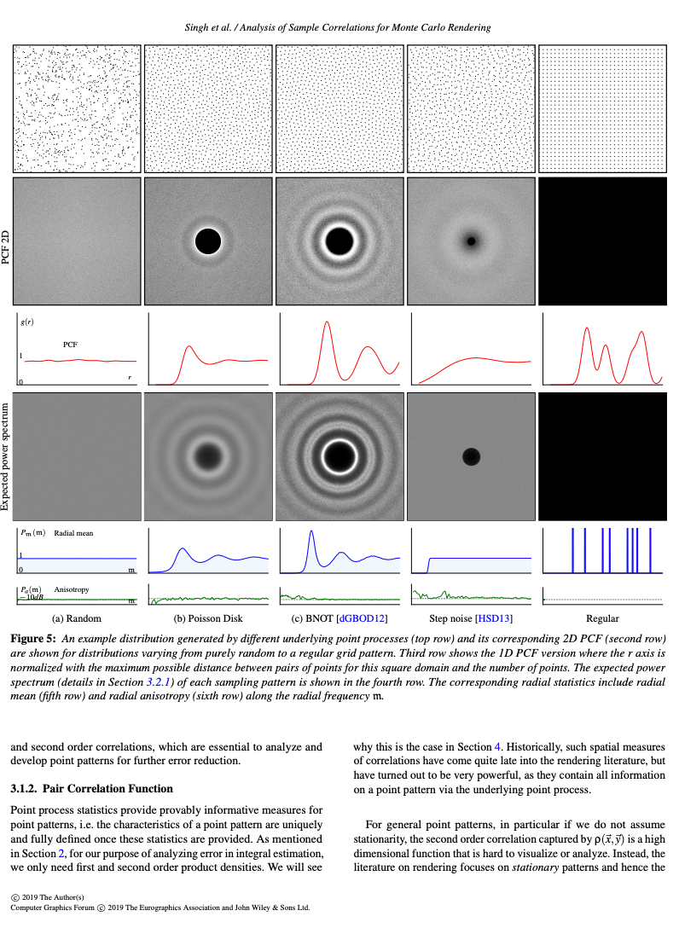
Evaluation (a.k.a. Results)
Quantitative evaluation
Comparison to previous work and “ground truth”
Measured performance or asymptotic analysis
Look at images & read captions on first reading pass
Beware of measurement differences between papers
Analysis of Sample Correlations for Monte Carlo Rendering, Singh et al., Eurographics'19

Slide 22
Conclusions & Discussion
Often begins with a skippable paper summary
Expansion of conclusions based on experimental results that first appeared in the abstract or title
Valuable high-level, subjective or philosophical discussion of what the authors learned from this research
Suggestions for future research (great ideas for your own work)

Slide 23

Reading Process
Burley et al., The Design and Evolution of Disney's Hyperion Renderer, ACM ToG 2018
Notes:
About 10% of a paper actually describes the new information that you’re trying to learn.
The rest is context and evaluation. Those are valuable, of course, but you need to first identify what the new piece to understand why the paper matters, whether you’re reading the right paper, and how important that new piece actually is to you (Does it produce good results? Does it execute efficiently? Does it have unacceptable constraints or limitations?) These are of course the same questions a reviewer is trying to answer!
Here’s how I read a realistic rendering paper. Some of this is rendering-specific (or Morgan-specific), but all scientists read in multiple passes and jump around within each pass roughly in this way.
As a running example, I’ll use the Kajiya ’86 paper that was assigned reading for today. I’m choosing that because it is the key paper from which everything else in this course follows, not because it is the most representative paper in its structure or the best-written paper (although it has a lot to like).
I’m going to show you how to read it right now, not how to present it. Please don’t structure your presentations like this!

Slide 24
Study Title & Teaser
What is this paper about? What do the words in the title really mean?
How does the best-case result in the teaser compare to prior art and the “ground truth” goal?
Is this paper likely the beginning, middle, or end of this line of research?
Check for backward references in the ACM Digital Library…see how those authors describe this paper in their related work, and maybe recursively start reading those papers.
When was it published (is there something newer I should read?)
[Do these authors and this venue have a reputation for clarity, objectivity, full disclosure, and practicality?]
Are there presentation slides or a video available that I can use for an easier overview?
Notes:
I spend several minutes trying to figure the paper out from just the title and teaser image (plus caption). The helps me to understand how important this paper will be (maybe I should spend my time reading something else first) and how to approach it.

Slide 25
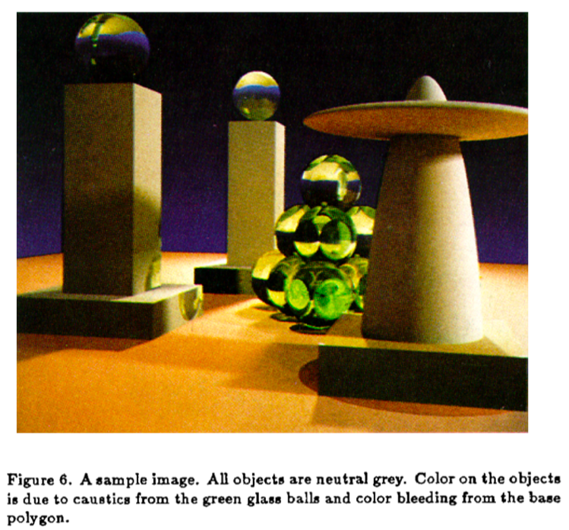
The Rendering Equation
James T. Kajiya
SIGGRAPH’86
J.T. Kajiya, The Rendering Equation, SIGGRAPH’86
Notes:
I’m going to use this paper as a running example. It predates teasers, but here’s the final image from the paper, which would have been a teaser in the modern format.
The title is “The Rendering Equation”. That’s awfully presumptuous. But it is clearly about introducing a formal framework for all rendering. So, I can expect to get some big picture perspective from this paper.
There are also pictures, so clearly I can also expect to get a rendering algorithm for solving that equation. As indicated by the caption, the image has very complicated lighting effects, so this algorithm must handle a pretty general case well.
This paper is from 1986 and has been cited 3,117 times according to the ACM. So, it must be a very important paper (100 citations for a rendering paper would be a lot). The algorithm as originally presented also must be somewhat dated, considering that there are at least three thousand more recent advances on this topic.
Kajiya was a professor at CalTech at the time and had coauthored about 30 previous papers, including with folks like Turner Whitted (the recursive “ray tracing” inventor) and Bill Dally (NVIDIA Chief Scientist), so he’s probably a credible and important person.
There’s no presentation by Kajiya online, but there are a lot of textbooks and surveys that describe this work, as well as many lecture notes that explain it. That won’t be the case for most papers, so let’s skip those for the moment and move on…

Slide 26
Read Abstract Closely(1/2)
What kind of paper is this?
New problem
New system solution
New theory solution
New data set
Survey
Position

Slide 27
Read Abstract Closely (2/2)
What problem is being addressed?
Why does that problem matter?
Why is a new solution needed?
What is the key idea to the new solution?
What is the main limitation/drawback/constraint?
How well does it work?

Slide 28
The Rendering Equation
Abstract.
We present an integral equation which generalizes a variety of known rendering algorithms. In the course of discussing a monte carlo solution we also present a new form of variance reduction, called Hierarchical sampling and give a number of elaborations shows that it may be an efficient new technique for a wide variety of monte carlo procedures. The resulting rendering algorithm extends the range of optical phenomena which can be effectively simulated.
J.T. Kajiya, The Rendering Equation, SIGGRAPH’86
Notes:
(there’s a missing comma after “sampling” and “shows” should probably be “that show”…this is verbatim from Kajiya’s abstract)

Slide 29
The Rendering Equation
Deliverables
Key idea
Abstract.
We present an integral equation which generalizes a variety of known rendering algorithms. In the course of discussing a monte carlo solution we also present a new form of variance reduction, called Hierarchical sampling and give a number of elaborations shows that it may be an efficient new technique for a wide variety of monte carlo procedures. The resulting rendering algorithm extends the range of optical phenomena which can be effectively simulated.
The problem
J.T. Kajiya, The Rendering Equation, SIGGRAPH’86
Notes:
The problem this paper addresses generalizing rendering so that it can address more optical phenomena. It is also seeking to reduce the variance (aliasing/noise) in Monte Carlo sampling.
The key idea is a new way of thinking about the problem. The titular “rendering equation” is going to be an integral equation that generalizes previous approaches.
There are three deliverables:
A general way of thinking about rendering (The Rendering Equation; not claimed to be entirely new)
A new algorithm for variance reduction (Hierarchical Sampling)
A new rendering algorithm (Path Tracing). This is buried a bit: it is “a monte carlo solution” + “the resulting rendering algorithm”
(The hierarchical sampling turns out to not be very important as applied in this paper. It is mostly an antialiasing method for primary rays which was soon replaced by the quasi-monte carlo methods that we’ll study in this course, and in its other applications by adaptive sampling and denoising. I point this out because recognizing what is NOT important to read right now is a key skill in working with research papers. There’s nothing in this abstract that indicates the Hierarchical Sampling is not the important part; rather, it actually seems like the most important part as it is the only named algorithm in the abstract. You need outside knowledge to recognize that it isn’t essential.)
The limitation of previous work is implicit: it cannot simulate a large range of phenomena
The one thing I’d change about this abstract to improve it is to be more explicit about how well the provided algorithms perform. What’s the asymptotic performance? (O(2^k) → O(k) for k scattering events, converges like sqrt(n) for n path samples per pixel). Wall clock time? (20 hours at 512x512) What some of these newly-simulated optical phenomena (caustics, glossy reflection, diffuse interreflection, natural extension to spectral and polarization rendering)? Do these methods fail to perform well in certain cases, such as narrow caustics, tiny apertures, or shiny surfaces under large lights? (hint: yes, it has problems there!)

Slide 30
Look for Contributions in the Introduction
Skip to the end of the introduction, where there is usually an explicit description of the contributions.
In modern papers, this is sometimes a convenient bulleted list.
Skim for any term of art definitions in italics or bold.

Slide 31
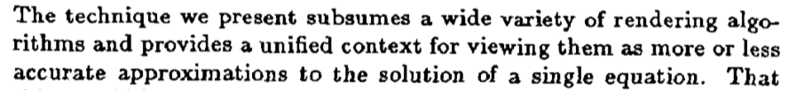
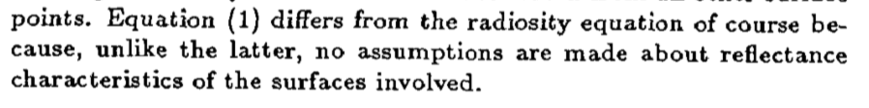
(Introduction)
…
J.T. Kajiya, The Rendering Equation, SIGGRAPH’86
Notes:
The contributions are:
the generality of the unified approach
no assumptions about reflectance
…
and one more contribution that is not mentioned in the introduction or title.
This is a major weakness of the paper’s exposition. This other unmentioned contribution turns out to be the most important aspect of the paper with the benefit of historical hindsight.
What is this contribution? Well, much later, at the very end of the algorithm section, Kajiya mentions:

Slide 32
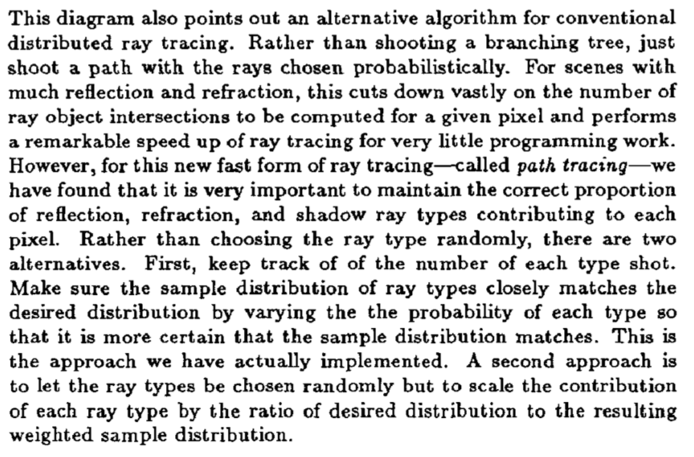
J.T. Kajiya, The Rendering Equation, SIGGRAPH’86
Notes:
This is the path tracing algorithm, which is the basis for this entire course. That’s why the paper was cited over 3000 times. This isn’t unusual, though…often when writing a paper, we don’t know which parts will stand the test of time. And to be fair, Kajiya’s insight of path tracing grew largely from thinking about the rendering equation (which was already known to others, as he points out, and is expressed better in the modern solid angle form by a simultaneously-published paper, Immel et al.’86!) in a new way, so he is right that the key insight is thinking about the problem differently and the algorithm “falls out” of that thinking.
To add more irony, this very last sentence, which describes a method that the author didn’t even bother to implement, is how path tracers are actually written today. It is a genius idea. But even geniuses can’t always recognize which of their own ideas are going to be important in the long run.
Having read all of this, we now wish the paper had been titled “the path tracing algorithm as a monte carlo solution to the rendering equation” and that “the path tracing algorithm” had been explicitly mentioned in the introduction as one of the contributions. Let’s give Kajiya credit, however, both for inventing the algorithm and for recognizing that thinking about the rendering problem as monte carlo estimators for a general rendering equation—both of which are core ideas to modern rendering and come from a single paper.

Slide 33
Skim Conclusions
After all of this work, what insight did the authors leave with?
Is this important enough to study the rest of the paper in detail?
Are there limitations disclosed here?

Slide 34
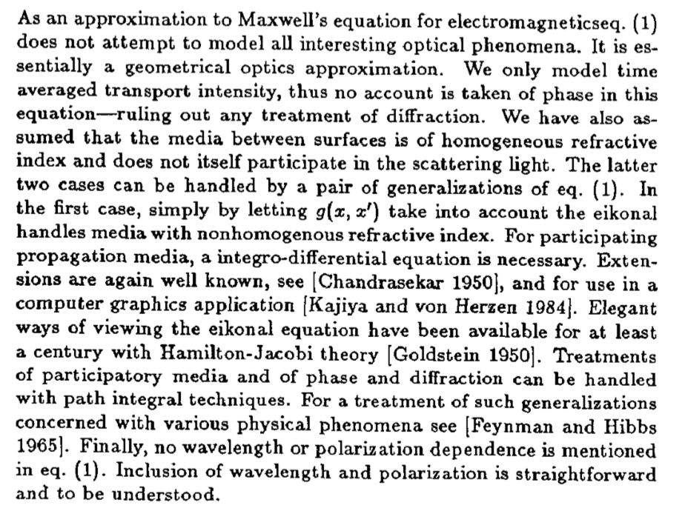
Limitations
Future work/
extensions
Limitations
J.T. Kajiya, The Rendering Equation, SIGGRAPH’86
Notes:
Kajiya oddly does not have any conclusions in this paper. That’s mostly because he front-loaded the philosophy and insights (older papers tend to do this). This is the end of the introduction section, which we’d expect to find at the end of the entire paper today.
He opened the entire paper with the “big conclusion: of thinking about rendering as a monte carlo solution for a stripped-down expression of Maxwell’s equations. Here we appropriately get a list of limitations and future work.

Slide 35
Skim Results, Emphasizing Data
How well does this perform? Absolute and scaling
How robust is the method across input variation?
How does the worst case quality differ from best case?
When do failure cases occur?
How do I tune parameters?

Slide 36
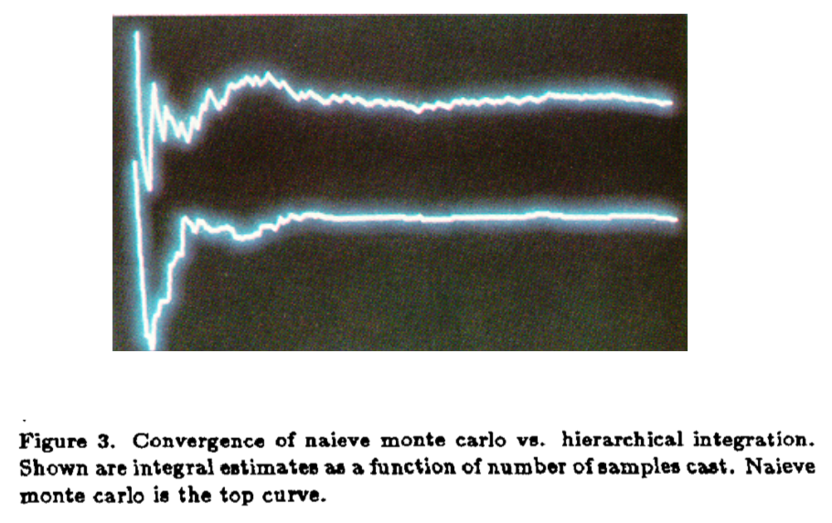
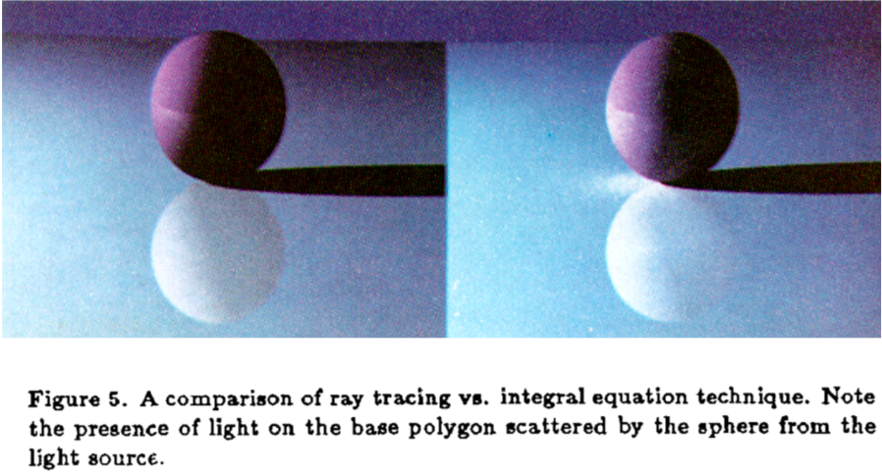
J.T. Kajiya, The Rendering Equation, SIGGRAPH’86
Notes:
This figure on the left shows two plots of a sequence converging, as value vs. time. The top one is the typical method. The bottom one is the new method. The new method appears to have less wiggle, so that looks good. Especially as it seems to hit the asymptote much earlier in time.
The figure on the right shows a rendered image before and after the technique. The sphere has more realistic lighting in the “after” picture on the right, as well as in the reflection. That’s the more important result from this paper and looks good. There is a clear improvement.

Slide 37
Skim Recent Related Work
How does this differ from the most closely-related previous work?
Restrictions
Performance
Robustness
Quality

Slide 38


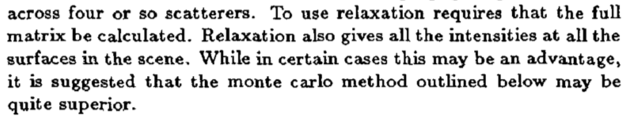
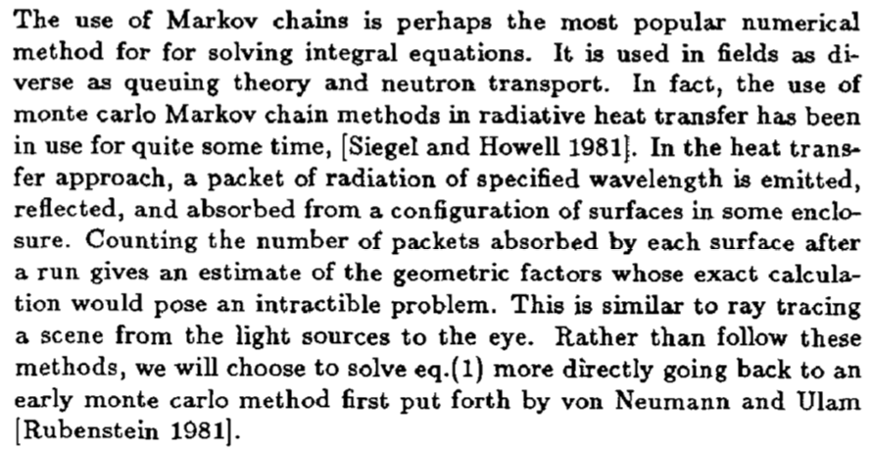
J.T. Kajiya, The Rendering Equation, SIGGRAPH’86
Notes:
The main related work section is titled “3. Methods for approximate solution” in this paper. The first sentence begins “In this section we shall review…”, which lets you know that.
Raster direct illumination approaches (“Utah”) are direct illumination only.
Distribution ray tracing computes a small number of recursive illumination paths, but assumes a hand-tuned “ambient” term for the infinite and diffuse reflections.
Radiosity only supports perfectly Lambertian reflectors and is slow.
Monte carlo simulation of light paths has been done in other fields, but starts at the light sources. I’m going to more efficiently go from the eye back to the light.
So: general solution, which follows closely on distribution ray tracing but attacks the “diffuse” interreflection term by using a direct monte carlo simulation of light paths from the eye. Not much new to the algorithm, but a new way of thinking about the problem will help it to scale better.

Slide 39
Skim the Algorithm/System Section
Read the section titles, but skip the content
Find the key listing or equation (usually at the end)
Decipher the notation
What is the magic “aha!” step?
Look for parameters, limitations, assumptions, and dependencies

Slide 40
Re-read Front Matter
Abstract, Introduction, Related Work
Does my interpretation of the abstract change?
Consider the positioning of the Introduction.
Does it give me insight into their approach or the problem in general?
Does it motivate the problem?
For the most closely related work, follow the reference and read their abstracts and teasers, maybe recursively reading those full papers.

Slide 41
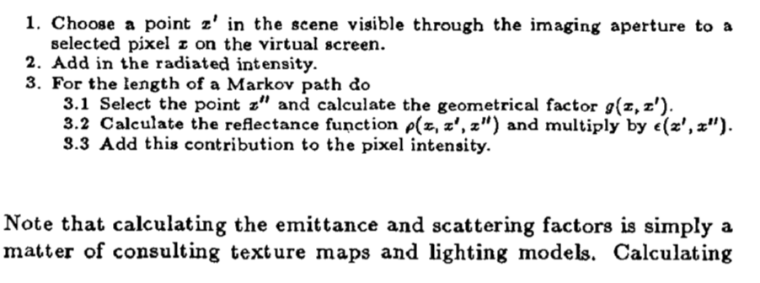
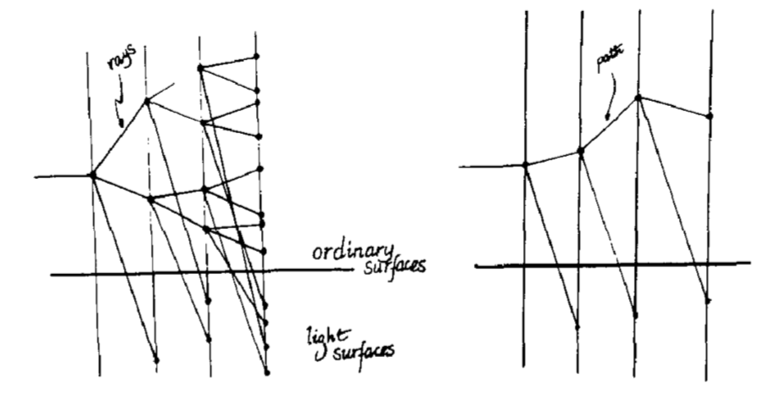
The path tracing algorithm
Distribution ray tracing (prior work): exponential time!
Path tracing: linear time!
J.T. Kajiya, The Rendering Equation, SIGGRAPH’86
Notes:
The key to understanding this paper is this (hand drawn!) diagram. What it is showing is light transport depicted as a tree search. The horizontal axis is recursive iterations (scattering event depth). The vertical axis is if you took all of the points in the scene and just sorted them into a line, with the lights on the bottom of the line. The diagonals drawn in are a trace of which points the algorithm considers as it iterates horizontally from left (starting at the eye) to right.
The algorithm at the top describes the same thing. All of the diagrams and equations in section 2 are complicated because Kajiya choose to express the integrals over points instead of angles. You can largely ignore them by just choosing the better (and modern) reference frame/parameterization for the integrals.
This is a brilliant piece of exposition. In one listing and one diagram he presents the core algorithmic result. You just have to stare at them for a week to catch all of the implications—most of the text isn’t as important. The core theoretical result was equation 1 on the first page of the paper. That’s quite the economy of writing!

Slide 42
Re-read Results
Read the Result text in full to really understand the evaluation.
Compare to results in previous (or future) papers…is there some case that you aren’t being shown?
Failure and limitation figures are good signs. Be worried about papers that don’t disclose these.
Notes:
Note that Kajiya was very up front about the limitations; on page 1 he told us all of the cases that the algorithm couldn’t handle. The result figures that we already considered showed nice comparisons to previous work. In the results section he also describes the performance in wall-clock time on an IBM 3081 computer, and he showed us graphically that the new solution is linear instead of exponential in path length.
He didn’t discuss or render any failure cases, but it took him 20 hours to render the two 512x512 result pictures which he had to photograph with a film camera because screenshots and digital typesetting didn’t yet exist, so you can probably understand why he stopped at two images.
Yet, that is a shortcoming of the paper…the difficulty of handling complicated chains of specular reflections from the light ending in a diffuse reflection into the eye (caustics) and very narrow apertures (such as a keyhole) is what motivates the great bidirectional path tracing, metropolis light transport, and photon mapping papers a decade later. Perhaps those solutions would have been invented sooner had Kajiya disclosed this problem.

Slide 43
Read the Algorithm Section
Now study the Algorithm/System main body.
Ensure that you understand every aspect of the notation (you may have to check other sections, other papers, books, etc.!)
Pay attention to hats, subscripts, superscripts, stars, etc. Beware of similar-looking symbols: W/omega, O/zero, L/one, V/nu, etc.
What size are matrices?
What are the units?
What do functions return?
If you’re trying to really understand this paper, then rederive the code or equations as you progress. The paper will skip steps to save space. You shouldn’t.
Notes:
If you are going to implement the paper, publish work that directly follows from it, or teach a detailed lecture on it, then you need to rederive the key results.
If you’re presenting the paper at a high level (as we do in this course), surveying it as tangential related work, or just learn about the big ideas, then you can skip that step.
I often find that by rederiving results I discover hidden gems. Maybe the paper (especially if it is a bit older) describes a contribution that is not directly relevant to the problem I’m working on…but a clever technique that they used to build their solution might be a great and reusable tool. Recall that the invention of the z-buffer was a footnote in Ed Catmull’s thesis.

Slide 44
Read the Conclusions. Think.
Notes:
Once you really understand a paper, the introduction and discussion sections can become the most important parts.
Unless this is provably the best possible result, the paper is likely describing a solution that will some day be obsolete.
But the approach that the authors took, the techniques that they leveraged, and the insights that they gained may be perpetually useful.
For the very best papers, the core algorithm and results that previously seemed so important may only be a vehicle for reaching a newly enlightened way of looking at the problem and the field. For rendering, I count Distributed Ray Tracing, The Rendering Equation, and Metropolis Light Transport papers among those where the big idea remains essential and beautiful even though the original algorithm and results are now obsolete.

Slide 45
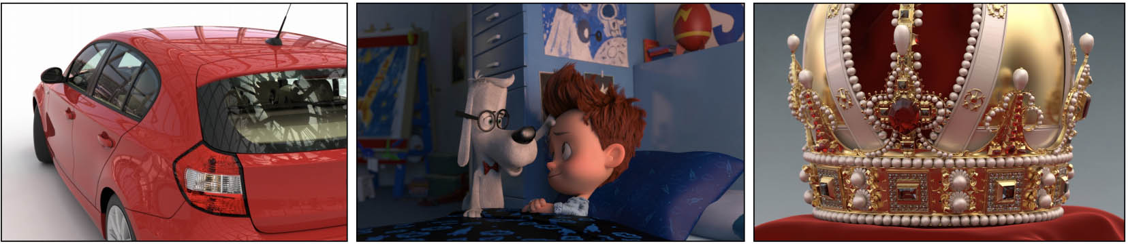
Summary
Wald et al., Embree: A Kernel Framework for Efficient CPU Ray Tracing, ACM ToG 2014

Slide 46
Many Motivations
Many reasons you might read a paper: learn scientific result, learn structure, meta-insights, review.
Many benefits from reading primary sources.
Consider the authors’ constraints and audiences when interpreting their words.

Slide 47
Read in Multiple Passes
Title/Teaser/Abstract
Contributions (in Introduction)
Skim Conclusions
Skim Results
Recent Related Work
Skim Algorithm/System
Abstract, Introduction, Related Work
Results
Algorithm/System…[maybe rederive!]
Conclusions
Stop?
Stop?
Stop?
Stop?
Notes:
Here’s the iterative process of how I read a research paper all on one slide.
Remember that I’m periodically deciding whether to continue.
I most frequently stop after step 6, having determined that this isn’t the paper I need to read right now.

